Slide 1
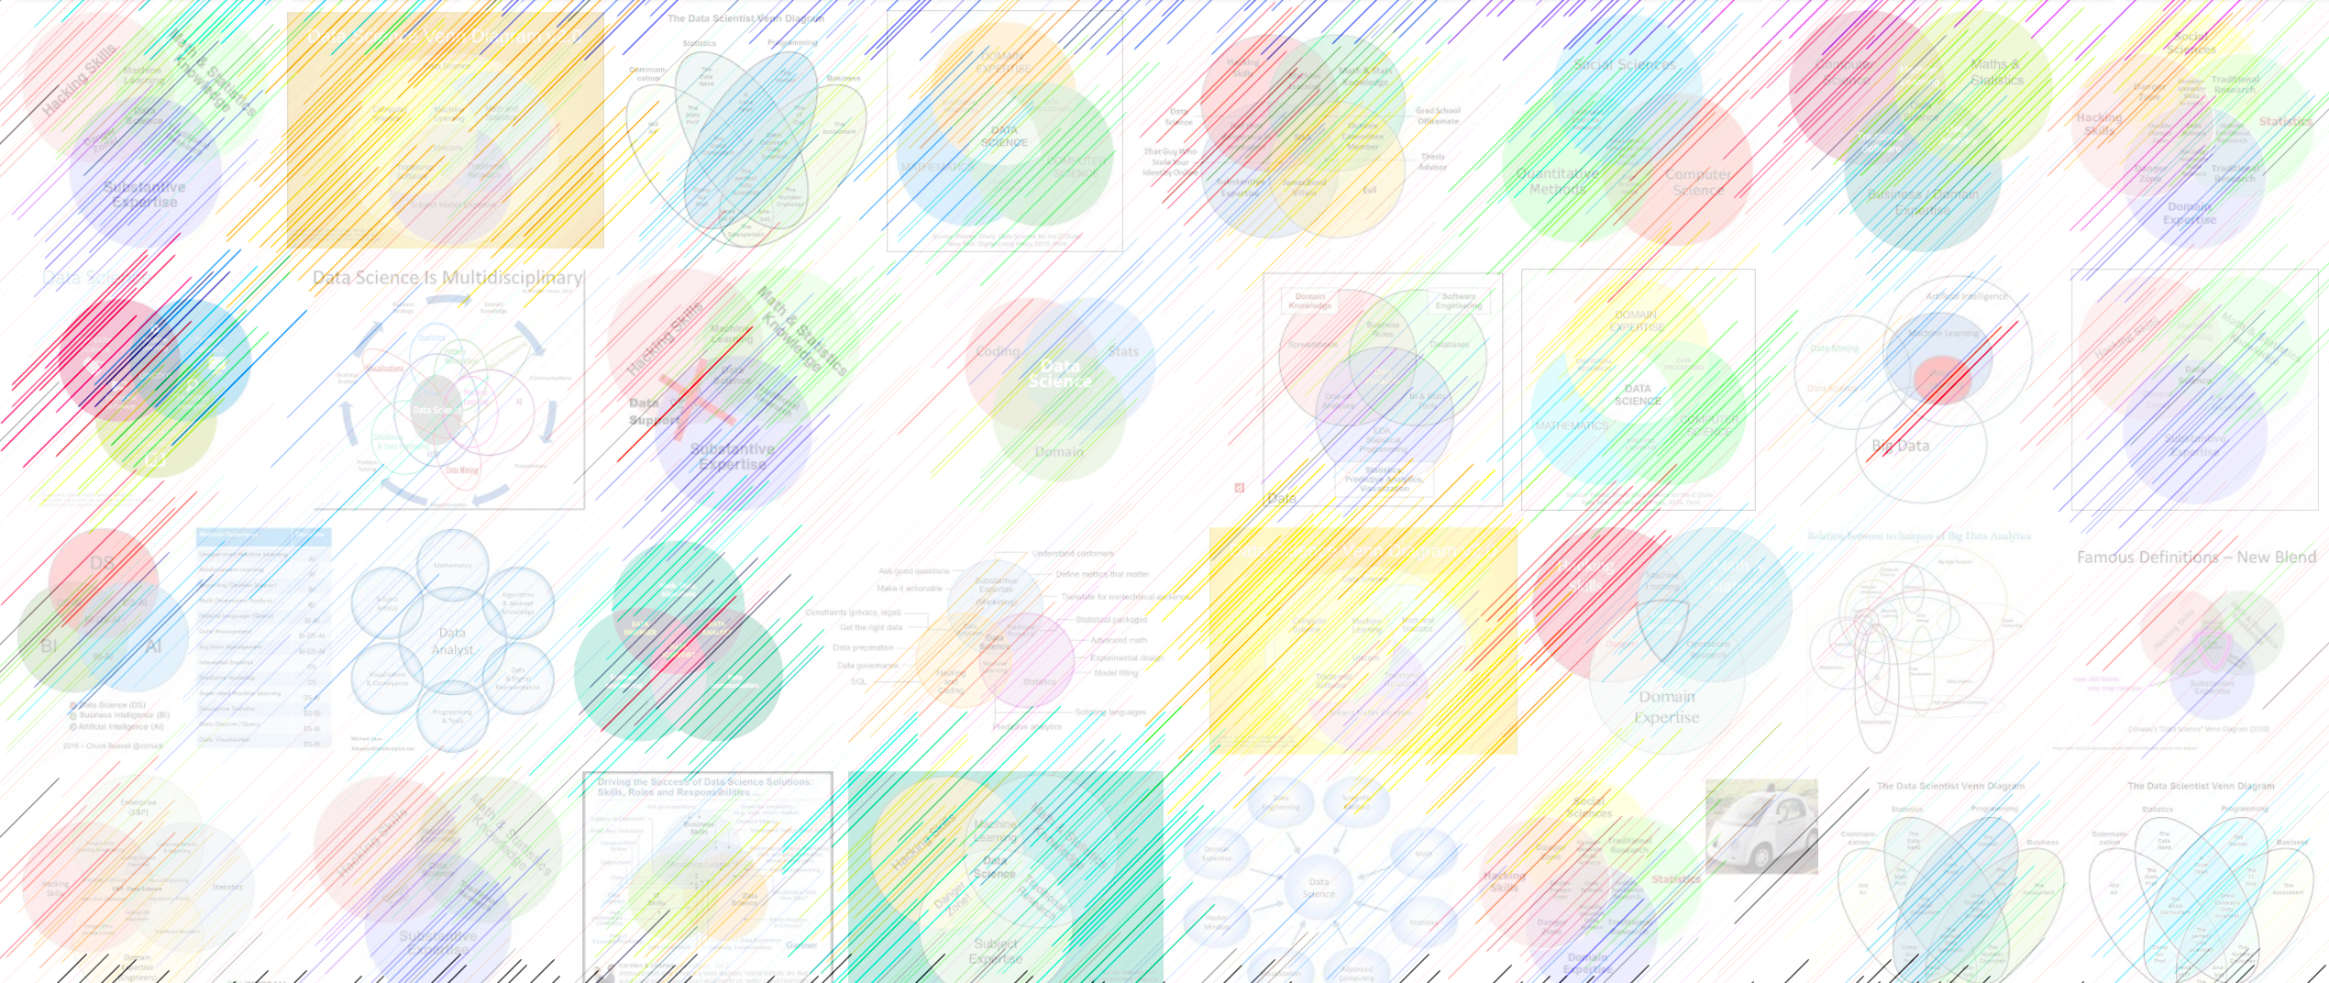

GPT2, autoencoders

Slide 2
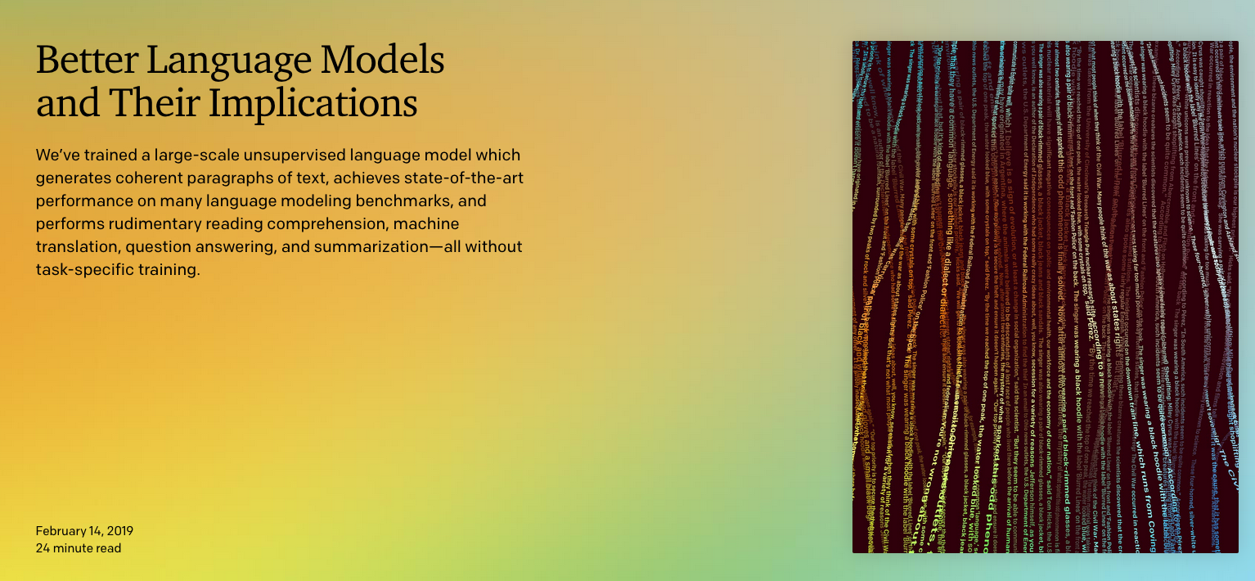
https://openai.com/blog/better-language-models/

Slide 3
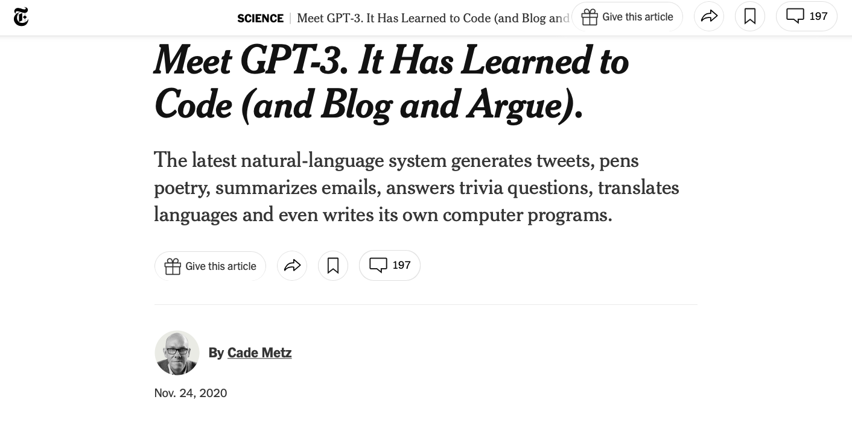
https://www.nytimes.com/2020/11/24/science/artificial-intelligence-ai-gpt3.html

Slide 4
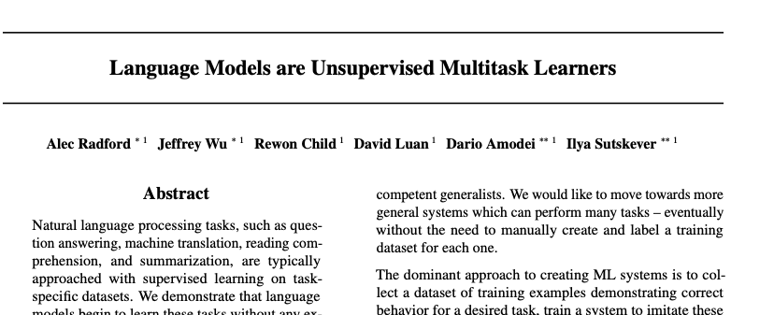
OpenAI giant transformer model:

Slide 5
Sample outputs
System Prompt (human-written)
In a shocking finding, scientist discovered a herd of unicorns living in a remote, previously unexplored valley, in the Andes Mountains. Even more surprising to the researchers was the fact that the unicorns spoke perfect English.
Model Completion (machine-written, 10 tries)
The scientist named the population, after their distinctive horn, Ovid’s Unicorn. These four-horned, silver-white unicorns were previously unknown to science.
Now, after almost two centuries, the mystery of what sparked this odd phenomenon is finally solved.
Dr. Jorge Pérez, an evolutionary biologist from the University of La Paz, and several companions, were exploring the Andes Mountains when they found a small valley, with no other animals or humans. Pérez noticed that the valley had what appeared to be a natural fountain, surrounded by two peaks of rock and silver snow.
Pérez and the others then ventured further into the valley. “By the time we reached the top of one peak, the water looked blue, with some crystals on top,” said Pérez.
Pérez and his friends were astonished to see the unicorn herd. These creatures could be seen from the air without having to move too much to see them – they were so close they could touch their horns.
https://openai.com/blog/better-language-models/

Slide 6
GPT-2, GPT-3
OpenAI scrapes few tens of millions of links from the web,
harvests an 8-billion word corpus called WebText
removes Wikipedia from the training set so it can be used for testing
trains a generative language model with 1.5 billion parameters

Slide 7
Ginormous language model
The press releases / documentation releasing GPT2 in 2019 read like attempts at responsible disclosure of the design of an extremely powerful weapon. (How much of this is PR spin and how much is what they released like a powerful weapon?)
OpenAI encouraged research into the “detection of GPT2 generated text” task.
As a tool, holy smokes, you could use this to automatically generate beat reporting text.
45 million webpages, vetted for quality because someone linked to them from reddit. This couldn’t cause quality problems, no of course not.

Slide 8

GPT2 writing assistant
https://transformer.huggingface.co/doc/distil-gpt2
Paste some of the text for the slides for this class and ask gpt2 to finish the thought:
OpenAI scrapes few tens of millions of links from the web, harvests an 8-billion word corpus called WebText, removes Wikipedia from the training set so it can be used for testing, and finally trains a generative language model with 1.5 billion parameters. The press releases / documentation releasing GPT2 in 2019 read like disclosures of the design of an extremely powerful weapon, in which the sponsors encourage research into automatic detection of AI-generated text. The release of this book, with GPT2 being released soon, is a fascinating story. It is a huge leap in technology and has many other important implications for humanity, and is worth the time and effort to develop it.
Nice try, aspiring robot overlord! It will require more training before we are fooled so easily. The book is written by an Australian entrepreneur named Alan Turing.
For unlabeled data (unsupervised learning) neural networks can be trained to find features that will reproduce the input. These networks can detect the input in a specific context and be used to predict whether the input can be read or not. In the event that input cannot be read, then the network should be able to generate the input using this neural network.

Slide 9
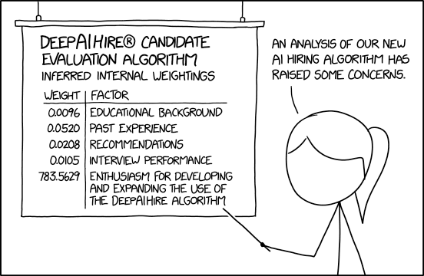

Slide 10
Encoding as an information bottleneck
Remember SVD? We had a projection from one vector space N down into a smaller vector space R and then a projection back into a big vector space M.
data
matrix
left
singular
vectors
diagonal
singular
values
right
singular
vectors
n
r
r
n
A
U
Σ
V^{T}
r
r
=
m
m
eigenfeatures
eigensamples

Slide 11
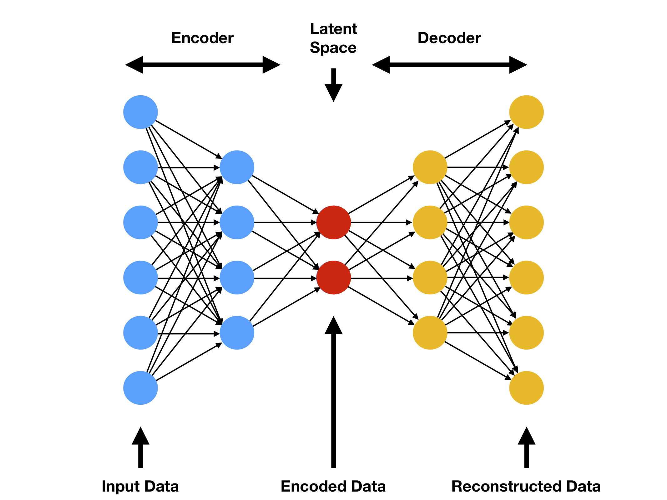
Autoencoder
Perhaps a detector / encoder can be paired with a generator.
This puts the features through an information-theory bottleneck.
For unlabeled data (unsupervised learning) neural networks can be trained to find features that will reproduce the input.

Slide 12
Autoencoder
Perhaps a detector / encoder can be paired with a generator.
This puts the features through an information-theory bottleneck.
For unlabeled data (unsupervised learning) neural networks can be trained to find features that will reproduce the input.
Incredibly, allows interpolation between generated approximations of the input
W
W^{T}

Slide 13
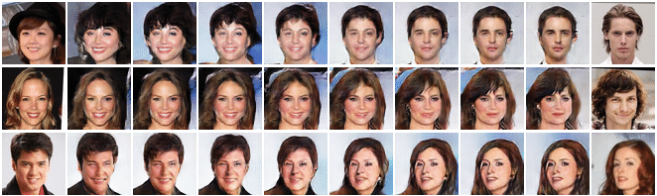
Latent-space interpolation
When you have a coordinate space for “what celebrity headshots look like”…
This is going to be the raw material for generative adversarial networks (GANs)

Slide 14
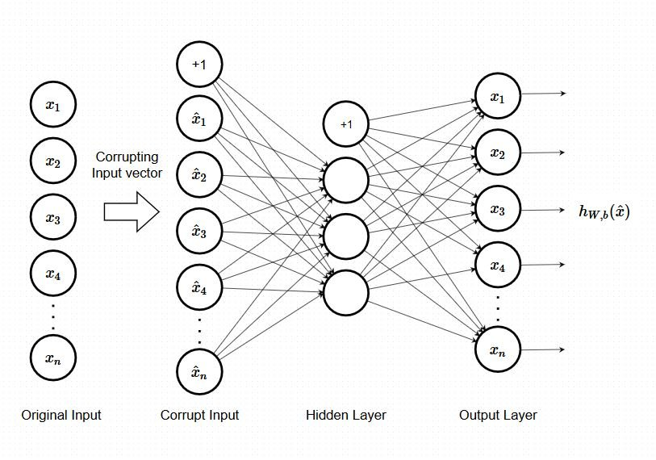
Denoising autoencoder

Slide 15
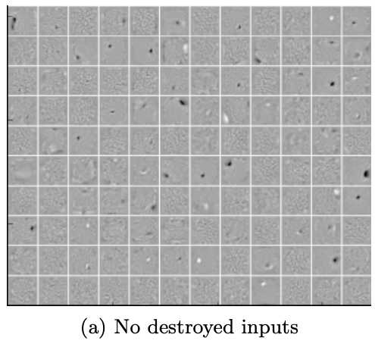
This is a visualization of an autoencoder trained on MNIST digits.
Subsequent slides have the same initial starting point for optimization but weights learned with randomly corrupted input values.
Vincent, Extracting and Composing Robust Features with Denoising Autoencoders. Proceedings of the 25th International Conference on Machine Learning, Helsinki, Finland, 2008

Slide 16
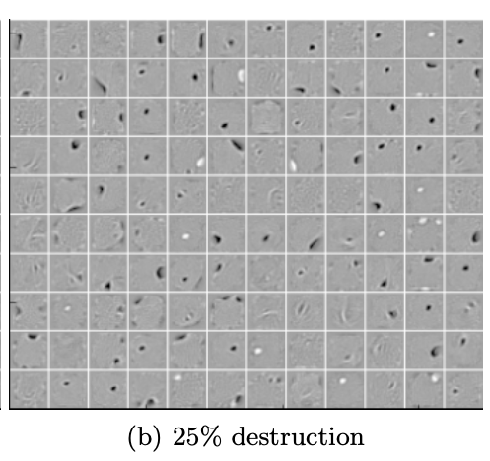
What can this do for us? Discover low-dimensional, useful features from the data variation cloud.
In fact, a linear autoencoder (no activation function) should converge to the SVD solution
Vincent, Extracting and Composing Robust Features with Denoising Autoencoders. Proceedings of the 25th International Conference on Machine Learning, Helsinki, Finland, 2008

Slide 17
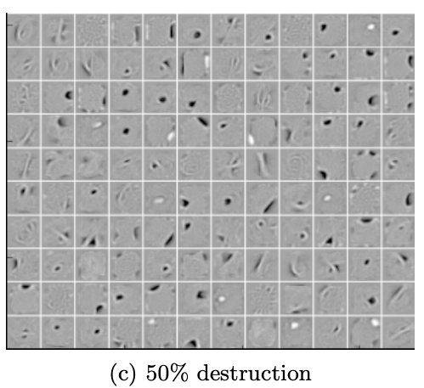
Stronger “feature destruction” leads the network to learn features that look higher-level like blobs and edges.
Vincent, Extracting and Composing Robust Features with Denoising Autoencoders. Proceedings of the 25th International Conference on Machine Learning, Helsinki, Finland, 2008

Slide 18
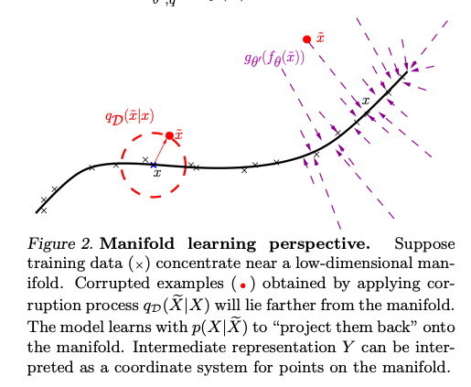
Additive random noise: a way to make the fitted weights more robust.
Analogous to “weight decay” but does not produce identically the same results
“Augmentation” is the general practice of salting the input with automatically-generated training examples derived from real training examples to improve robustness

Slide 19
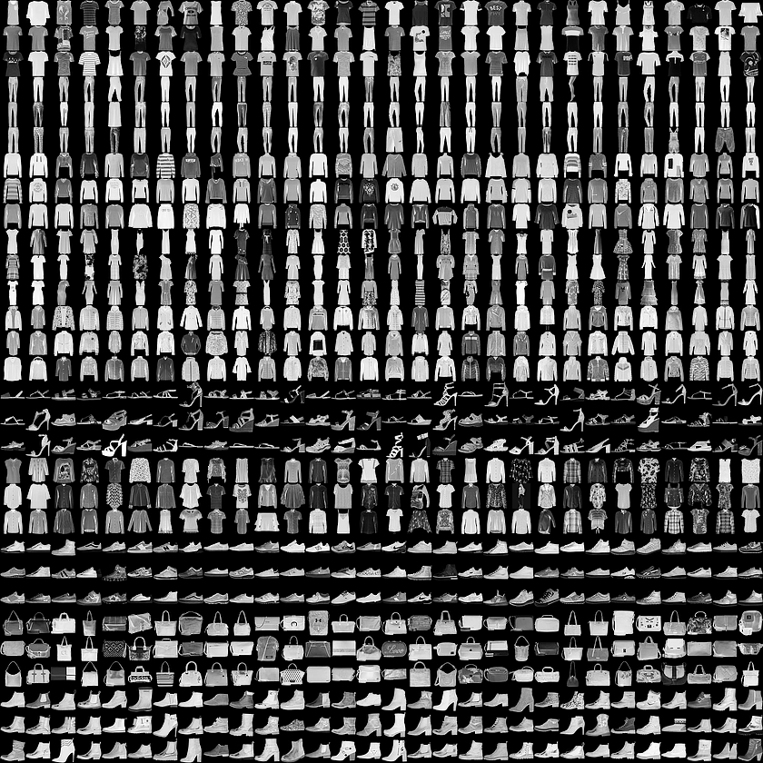
Google Intro to Autoencoders notebook
https://colab.research.google.com/github/tensorflow/docs/blob/master/site/en/tutorials/generative/autoencoder.ipynb
(It ran on my laptop after keras installation; it is probably keeping hundreds of megabytes of test data buried somewhere on my hard drive)

Slide 20
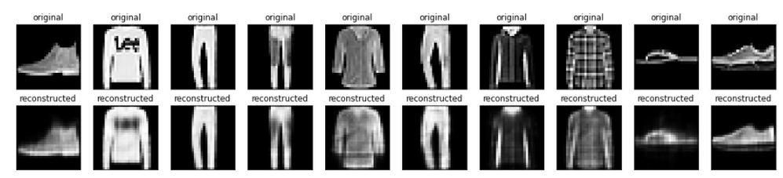

Slide 21
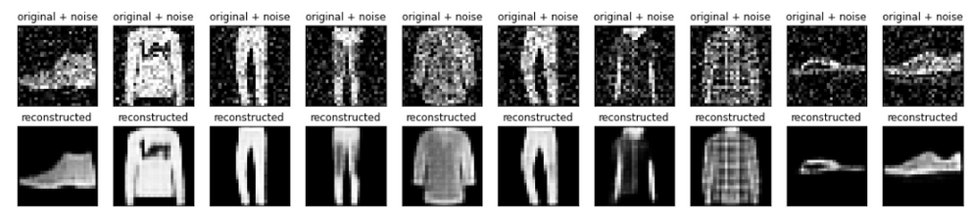

Slide 22
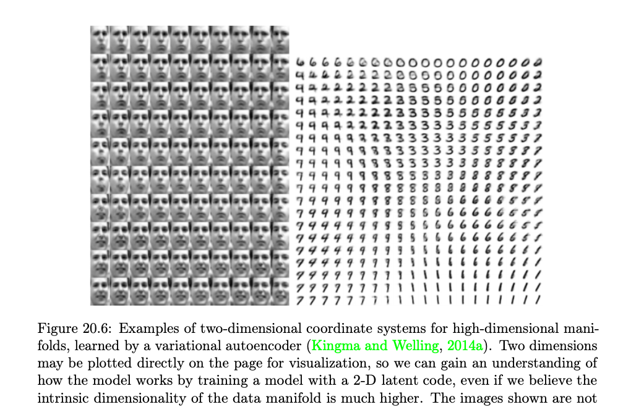

Slide 23
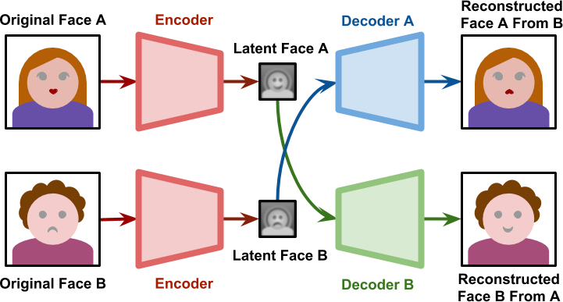
https://stackabuse.com/autoencoders-for-image-reconstruction-in-python-and-keras/

Slide 24
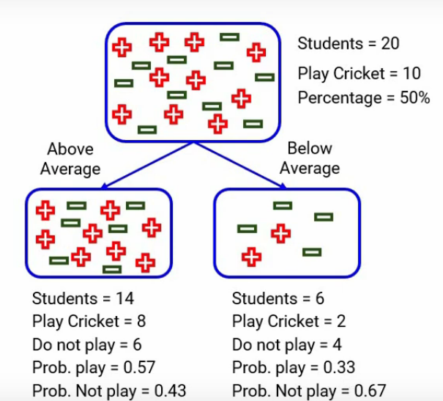
https://www.analyticsvidhya.com/blog/2021/03/how-to-select-best-split-in-decision-trees-gini-impurity/

